Slide 1

ACPS @ Home Update

Slide 2
Virginia Department of Education States:
Access to broadband is unevenly dispersed, creating a digital divide that affects educational opportunities for our students = Learning @ Home Gap
“The Learning @ Home Gap” describes a multitude of missed learning and life opportunities by students who lack access to technology and/or high-speed, broadband internet.
Definition of Broadband:
The Commonwealth defines it as 10 Mbps. The FCC defines it as 25 Mbps.
Broadband service is no longer a luxury. It has become a basic part of the infrastructure of education and democracy. Consortium of School Networking CoSN
Reference: Commonwealth Connect

Slide 3
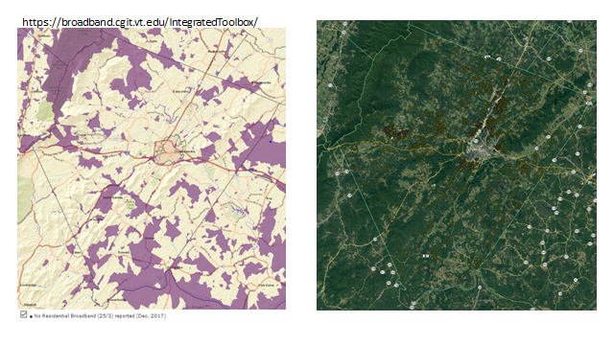
Countywide Connectivity for Students
Our Northern Feeder Pattern Area
Charlottesville
Our Southern Feeder Pattern Area
Source: State Broadband Database

Slide 4
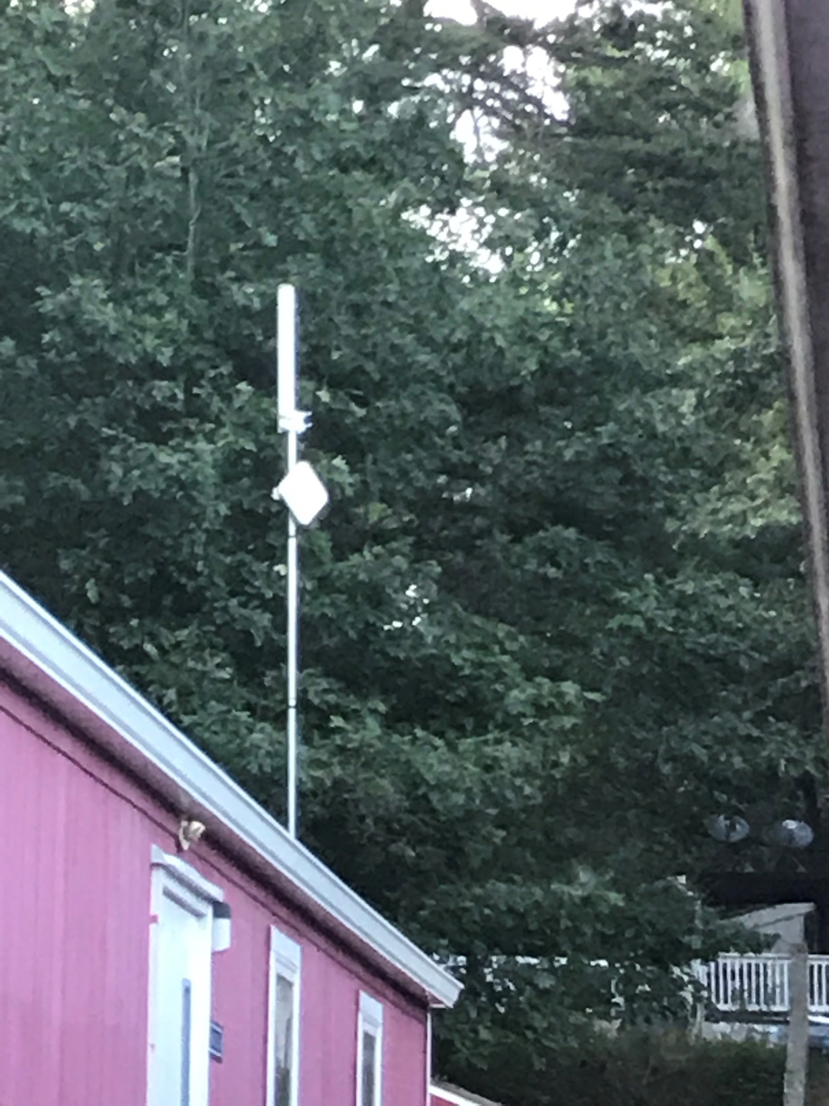
Requirements & Realities
ACPS Educational Broadband Services (EBS)
Climbing contractors required for most installs
Dependent on high speed fiber in proximity
Electrical installation dependencies exist
Questions about towers on school properties
Departmental staff availability for infrastructure installations
Topographical challenges

Slide 5
Current Equipment State
School Location | Location Type | Range Based on Avg. Topography | Connection Speeds | Status of Service
Agnor-Hurt | Roof | 1 mile | Avg. 3-10 Mbps | Identifying Students
Albemarle High | 125’ Tower | 2 miles | Avg. 3-10 Mbps | Power & Fiber Construction
Carter’s Mountain | ECC Tower 140’ Elevation | Approx. 9 miles | Avg. 3-10 Mbps | 100 units at Southwood
Scottsville | Roof | 1 mile | Avg. 3-10 Mbps | Identifying Students
Western | 100’ Tower | 1-2 miles | Avg. 3-10 Mbps | In process

Slide 6
Future Possibilities
School Location | Location Type | Range Based on Avg. Topography | Connection Speeds | Status of Service
Buck’s Elbow Tower | 140’ Tower | Approx. 9 miles | Avg. 3-10 Mbps | Under Construction/ Reserved Space
Peter’s Mountain | 120’ Tower | Approx. 9 miles | Avg. 3-10 Mbps | Awaiting Space on Tower
Fan Mountain | 120’ Tower | Approx. 3 miles | Avg. 3-10 Mbps | Awaiting Space on Tower
5th St. Tower | Under Design | Under Design | Under Design | Preliminary Design

Slide 7
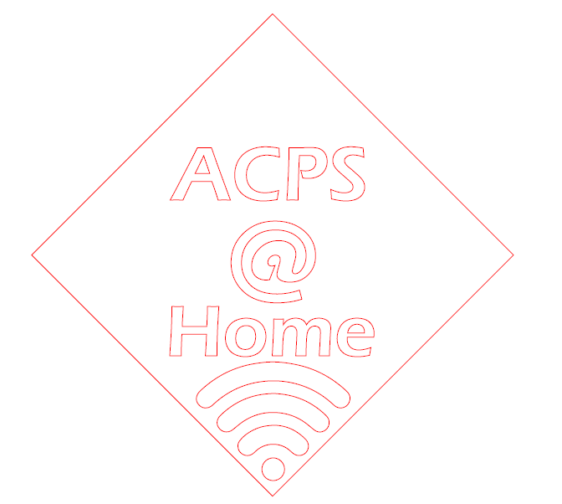


Achieving Digital Equity:
A Combination Approach
Establish Commercial Partnerships to Deploy 4G LTE Hotspots to out of range family locations (Providing 10-100 Mbps)
Promote Low Cost Internet Programs where available
Monitor County Government project to increase connectivity throughout the county

Slide 8
Our Digital Equity Goal for this New Approach:
90% Availability by 2021
“Digital Equity” is a condition in which all individuals and communities have the information technology capacity needed for full participation in our society, democracy and economy. Digital Equity is necessary for civic and cultural participation, employment, lifelong learning, and access to essential services.
National Digital Inclusion Alliance
Questions?

